Slide 1

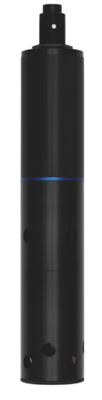
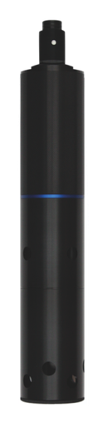
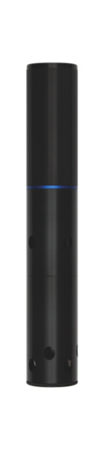

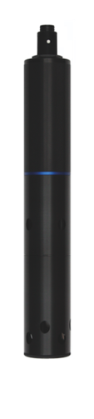


2015 Aquaread Product Range
www.aquaread.com info@aquaread.com +44 1843 600 030

Slide 2
New for 2015… our latest developments
Sensor updates:
• Changes to turbidity - You are now able to calibrate turbidity at 20NTU. This makes the readings sub 30NTU far more accurate and repeatable. This is effective now on any new Aquaprobes purchased. We have also redesigned the end cap on the AP-2000 to further reduce light effects
• Changes to EC - We have further improved the accuracy and repeatability of the conductivity readings at both the extreme high and low ends of the scale. The result of these changes mean that you can accurately monitor further from your point of calibration.
• Low Power Auto Data Logging - The GPS Aquameters now come with a new setting when using auto data logging. The new low power mode will actually shut the meter to sleep between readings meaning you can automatically log data for up to 38 days with one set of batteries!
EWS - In the UK flooding is a regular and very costly problem. The Leveline-EWS is designed to provide people and communities with warnings of rising water levels via SMS and Email, giving them a chance to react and protect their assets, even if the flood occurs in the middle of the night.
AquaStation - The Aquastation is a remote water quality monitoring station with a difference. This self-contained monitoring cabinet features our AP-7000 Aquaprobe with its self cleaning capabilities. This is combined with various pumps and valves to bring in sample water for test and to bring in calibration solutions allowing the AP-7000 to be calibrated remotely.
New Products
www.aquaread.com info@aquaread.com +44 1843 600 030

Slide 3
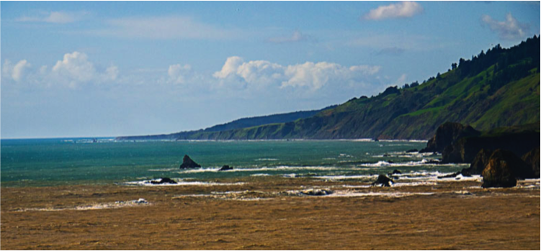
Sensor details: CDOM / FDOM… Latest sensor explained
CDOM / FDOM
CDOM stands for Coloured Dissolved Organic Matter
FDOM stands for Fluorescent Dissolved Organic Matter
CDOM occurs naturally in aquatic environments and has many different forms. CDOM absorbs UV light and fluoresces as a result allowing us to measure the relative amount of fluorescent material present
CDOM levels can have a significant effect on the aquatic environment so it is important that we are able to measure their trends
Because CDOM absorbs UV light, elevated levels can inhibit phytoplankton growth and also limit photosynthesis damaging the food chain and oxygen production in our oceans
Our CDOM sensor offers a 0 – 20,000µg/L range, with 2 auto ranging scales for high resolution at low levels
This optical sensor can be used with any Aquaprobe with an optical auxiliary port, though we recommend its use in the AP-7000 designed for long term deployments
Clean non turbid water appears blue because it absorbs low wavelength red light. The colour of water changes from blue to green to green-yellow to brown as the level of CDOM increases and its light absorption properties change
Here a river estuary high in CDOM meets an ocean
www.aquaread.com info@aquaread.com +44 1843 600 030

Slide 4
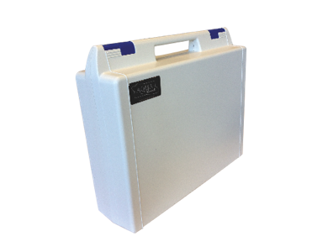
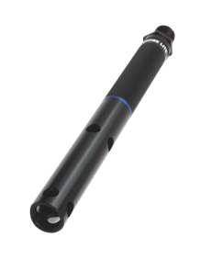
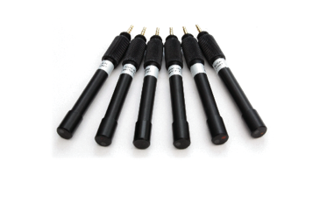
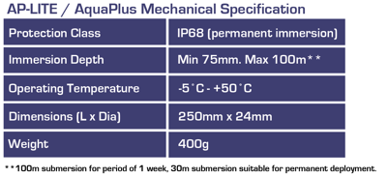
The AP-LITE Package Single parameter portable system
Single parameter monitoring with the AP-LITE package
Package contains the AP-LITE probe, 3m cable with AquaConn connectors, GPS Aquameter, PC software and a host of accessories
The AP-LITE probe can be used with any of our optical sensors which are easily connected to the probe’s sensor port
Turbidity and Chlorophyll sensors are of particular interest to many customers as there are very few similar products available
Optical Sensors for AP-LITE
  Turbidity
  Chlorophyll a
  Algae
  Rhodamine
  Fluorescein
  Refined Oil
  CDOM/FDOM
www.aquaread.com info@aquaread.com +44 1843 600 030

Slide 5
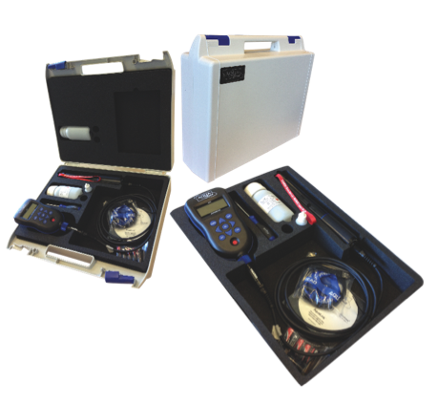
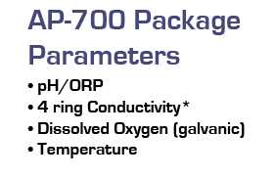
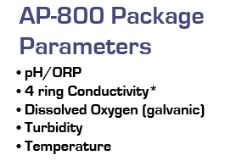
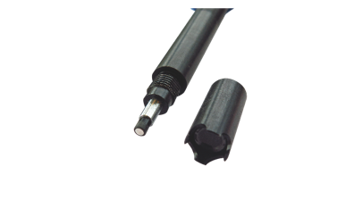
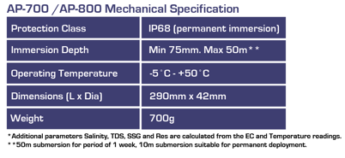
The AP-700 / 800 Packages Entry level water quality packages
The AP-700 and AP-800 are our entry level instruments.
They are designed to cover the most frequently requested parameters pH, ORP, EC, DO, Temp and Turbidity
(Depth sensors can be fitted to both probes where required)
As they are only available as a package they come as a complete set including Aquaprobe, 3m cable connected to
the probe, GPS Aquameter, calibration solutions and
other accessories
New Rugged Galvanic DO sensor
AP-700/800 both feature a newly designed rugged galvanic DO sensor tip. The solid zinc electrode is much more resistant to corrosion than earlier versions of the sensor
www.aquaread.com info@aquaread.com +44 1843 600 030

Slide 6
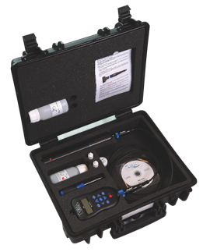
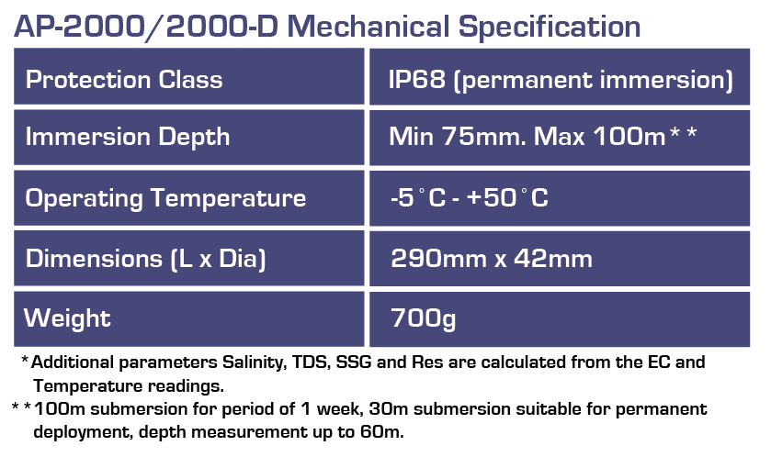
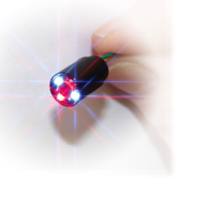
The AP-2000 Package Advanced portable water quality package
The AP-2000 Package offers the customer a more advanced water monitoring package and is capable of measuring up to 12 parameters
Advantages:
• Optical Dissolved oxygen sensor, see advantages below
• Exchangeable cables
• 2 Auxiliary ports allowing you to add 1 ISE and 1 Optical sensor to the probe
Included Sensors
Optical DO, Conductivity*, pH/ORP, Temperature,
2 customisable sensor ports and the option to add depth
The AP-2000 features advanced optical DO technology offering some significant advantages
• No flow of water required for stable reading
• Reduced maintenance: holds calibration for
up to 6 months and does not need cap and
solution replacement
• Reduced membrane fouling optimises sensor
for long term deployment
www.aquaread.com info@aquaread.com +44 1843 600 030

Slide 7
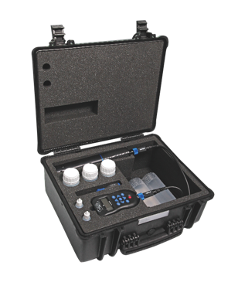
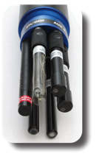
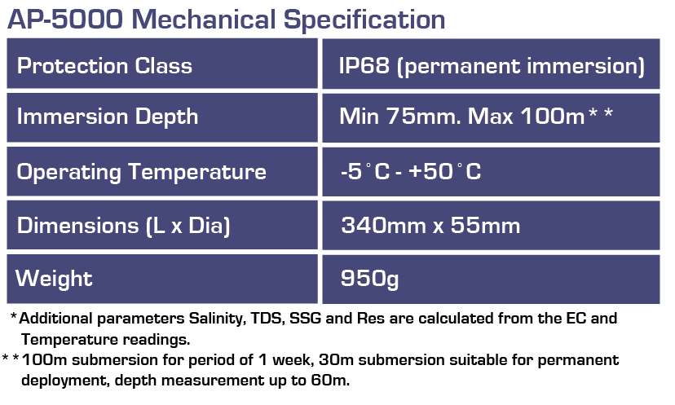
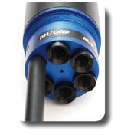
The AP-5000 Package Advanced portable water quality package
The AP-5000 Package offers the customer further flexibility and greater sensor capacity and is capable of recording 14 parameters
The AP-5000 probe comes with Optical DO, Conductivity*, pH/ORP, Temperature and Depth as standard plus 4 unrestricted auxiliary ports
This package also comes fully supplied and packed in a rugged case as shown, that is capable of holding a 20m extension cable
This system is particularly useful if a customer wants to measure Turbidity and another optical parameter in the same probe, which is not possible on the AP-2000
Unrestricted Sensor Ports
The sensor ports on the AP-5000 can take any combination of optical or ISE sensors allowing many possible combinations
www.aquaread.com info@aquaread.com +44 1843 600 030

Slide 8
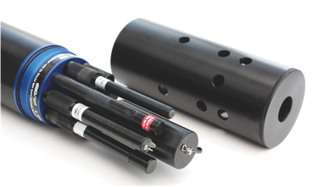
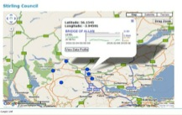
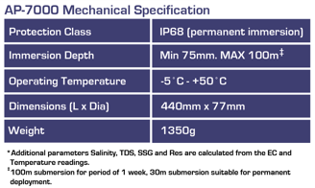
The AP-7000 Package For long term unmanned deployments
The AP-7000 probe comes with Optical DO, Conductivity*, pH/ORP, Temperature, Depth.
Probe has 6 customisable sensor ports allowing you to record up to 16 parameters at once
Wiper cleans all of the sensors that are connected to the probe, keeping sensors cleaner for longer
AP-7000 with Telemetry
Use the AP-7000 with Telemetry for the ultimate extended deployment
Bring data right to your PC and view all of your deployments via Timeview
AP-7000 At Sea
Hard-anodized marine grade aluminium used throughout our range is perfect for use in all water types, even salt water
Did you know…
The smooth surface of our probe body offers resistance to biofouling seen on many plastic bodied probes
www.aquaread.com info@aquaread.com +44 1843 600 030

Slide 9
Aquaread Parameters
Aquaread offer the following parameters:
Standard Parameters
Optical Dissolved Oxygen
Galvanic Dissolved Oxygen
pH
ORP
Electrical conductivity
Salinity
Resistivity
TDS
SSG
Temperature
Depth / Level
Ion Selective Electrodes
Ammonium / Ammonia
Nitrate
Chloride
Calcium
Fluoride
Optical Sensors
Turbidity
Chlorophyll a
Phycocyanin (BGA-PC)
Phycoerythrin (BGA-PE)
Rhodamine
Fluorescein
Refined Oil
CDOM / FDOM
Go to our new web site’s ‘Need Help?’ section to discover more about each and every parameter we measure
www.aquaread.com info@aquaread.com +44 1843 600 030

Slide 10

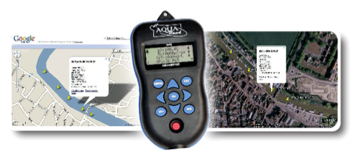
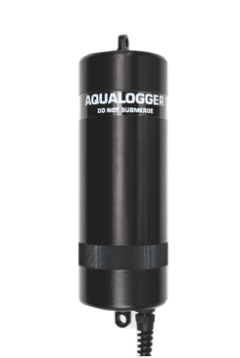
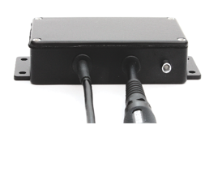
Aquaread Logging Options
GPS Aquameter
The GPS Aquameter is rated IP67 for use outside even in the rain. It is rugged and very easy to use. Record your data at the push of a button and download the data to a PC for manipulation and reporting. The integrated GPS means you will always know where your data was captured
New low power auto data logging mode sends the meter to sleep between readings allowing it to log data automatically for up to 38 days on a single set of batteries
AquaLogger
The AquaLogger is designed for long term unmanned logging. It is available in 2 different sizes, the AquaLogger-2000 is for use with the AP-LITE, and the AP-2000. The AquaLogger-7000 is for use with the AP-5000 and the AP-7000. Both systems will record data for up to 6 months on standard alkaline ‘C’ cell batteries and can hold up to 32,000 full data sets
BlackBox
The BlackBox is a data converter that facilitates connection of any Aquaprobe to existing data networks via SDI-12 and Modbus. Use it to connect to third party loggers, telemetry devices and PLC systems
www.aquaread.com info@aquaread.com +44 1843 600 030

Slide 11
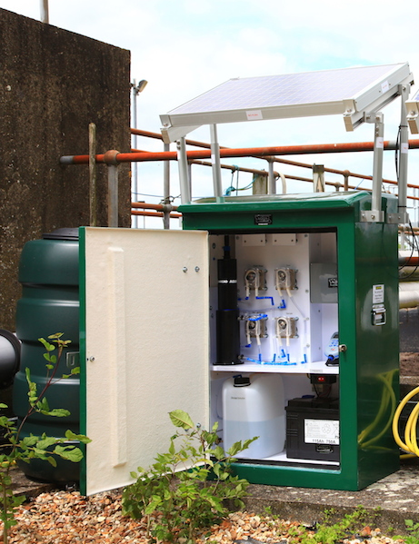
AquaStation Remote Monitoring Unit
The AQUASTATION
Monitor water quality in remote areas with fewer site visits
The AquaStation can independently
• Take test samples using the integrated AP-7000
• Clean all water quality sensors installed on the AP-7000
• Calibrate 4 key parameters
• Self powered (solar/wind)
• Send data via GPRS /3G for on-line access
• Raise alarms if alarm conditions are met
These key features allow this data collecting station to run without human interaction for much longer than previously possible thanks to the novel auto calibration feature.
www.aquaread.com info@aquaread.com +44 1843 600 030

Slide 12

Using an Aquaprobe as a Water Level Logger
Our Aquaprobes now feature improved
depth accuracy specifications:
AP-2000 + AP-5000: ±0.5%FS
AP-7000: ±0.2%FS
How do you log level with an Aquaprobe?
Make sure depth reads 0 before its submerged
Lower probe to desired depth
When probe is at desired depth and secured in place, zero the depth on the meter by pressing the OK button
Now changes will be logged as a + or – change compared to zero indicating level change
Depth readings are already compensated for air pressure changes, taking the air pressure from either the Aquameter, AquaLogger or Blackbox it is connected to – so no need for post-collection compensation.
To put this into perspective, here are some accuracy specifications for water level loggers:
(details taken from manufacturers’ published specifications online)
In-Situ Level TROLL: 300 ±0.2%FS
Aquaread LeveLine-ECO: ±0.2%FS
Cera Diver: ±0.2%FS
CTD Diver: ±0.2%FS
Aquaprobe pressure sensors are located between the sockets on the AP-2000 and AP-5000
www.aquaread.com info@aquaread.com +44 1843 600 030

Slide 13
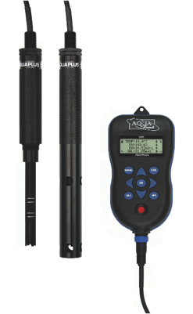

AquaPlus Optical DO/EC/Temperature system
The AquaPlus is a portable system for measuring DO, EC and temperature.
Its built-in conductivity sensor facilitates salinity measurement, which in turn allows automatic salinity compensation. The package includes a 3m cable, a GPS AquaPlus meter, the OxiLink PC application and a hard carry case
Optical sensors offer significant advantages over
galvanic based DO sensors:
• Oxygen is not consumed by the sensor so no flow of water is required
• Sensor holds calibration well and requires little maintenance
• Low maintenance cost with caps lasting over 2 years
www.aquaread.com info@aquaread.com +44 1843 600 030

Slide 14
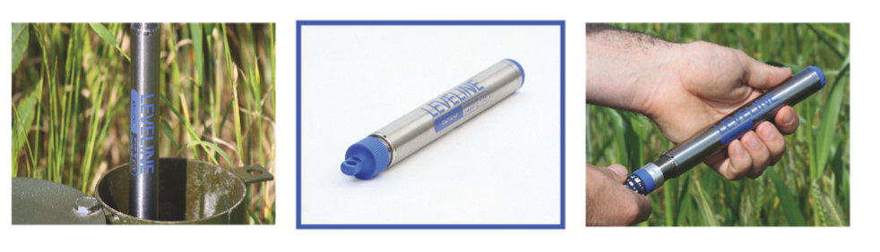
2015 LeveLine Range
Water Level and Temperature Loggers
www.aquaread.com info@aquaread.com +44 1843 600 030

Slide 15
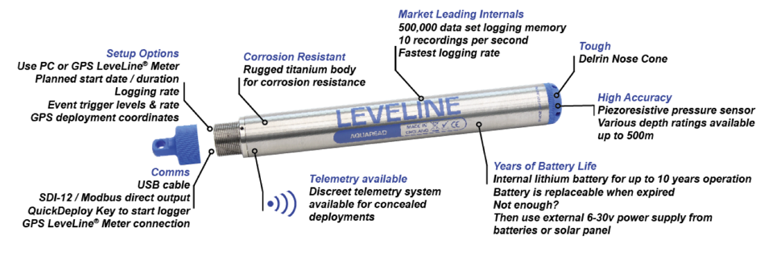
The Titanium LeveLine Water Level and Temperature logger
The LeveLine is available with absolute or gauge sensor depending on requirements
It features a huge 500,000 data point memory & has over 5 years battery life (battery is replaceable)
SDI-12 or Modbus output as standard for easy connection to any data logger or telemetry device
www.aquaread.com info@aquaread.com +44 1843 600 030

Slide 16
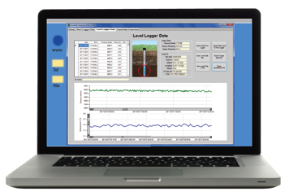
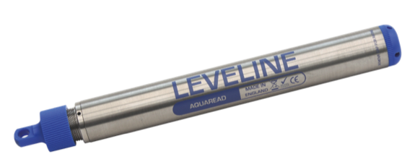
LeveLine-ECO A cost effective approach with great specification
LeveLine-ECO features
• Stainless steel body: ideal for deployment in fresh water (see LeveLine Titanium for marine deployments)
• Available as absolute setup: keeps the deployment simple and robust
• 150,000 data point memory: no need to worry about running out of memory
• Log level changes up to 5 times per second: high spec feature on an entry-level instrument
• Replaceable battery: dealer replaceable for extended instrument life and no fear of leaks
• Unbeatable price point: see how much you can save on this fantastic entry-level logger
LeveLink PC application is available in our PC-KIT
This simple software package allows all kinds of post-compensation as well as various export options such as csv or Google Earth files
www.aquaread.com info@aquaread.com +44 1843 600 030

Slide 17
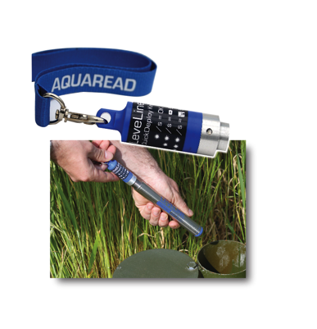
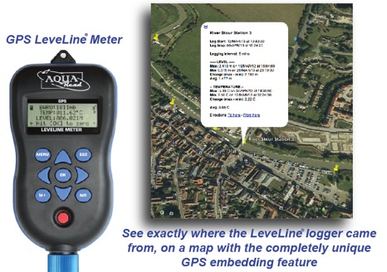
LeveLine Accessories Unique benefits of Aquaread Instruments
QuickDeploy Key
Simply plug the QuickDeploy key into the logger’s connector as the unit is deployed to:
• Zero the depth sensor to measure absolute depth from the start
• Initiate your pre-programmed logging scheme at the exact instant of
deployment and check the battery and memory levels are OK
GPS LeveLine® Meter
• Full on-site logger setup, data storage and live monitoring
• Embed the GPS coordinates in the LeveLine’s memory as it is deployed, so that it appears as part of the dataset upon retrieval
• Measure barometric air pressure and add a salinity value for auto compensation
• Download data from multiple loggers using the LeveLine Meter’s extended memory
www.aquaread.com info@aquaread.com +44 1843 600 030

Slide 18
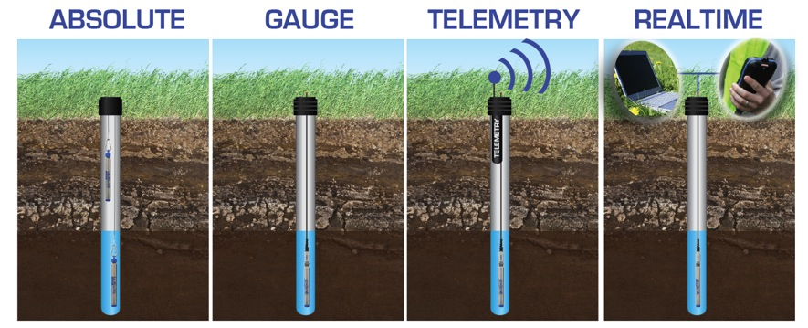
Deployment Options Absolute vs Gauge and telemetry options
Using the LeveLine logger under the water’s surface and using the Baro-logger to record changes to air pressure, for post-compensation
LeveLine logger uses a vented cable for continuous barometric compensation, no post-compensation required, Ideal for telemetry installations
LeveLine logger with cable connected directly to our discreet telemetry system. View data on a PC and set up auto emails during alarm events
Read the changes in level in real time when using the GPS LeveLine meter, or use LeveLink software to view data in real time on your laptop
www.aquaread.com info@aquaread.com +44 1843 600 030

Slide 19
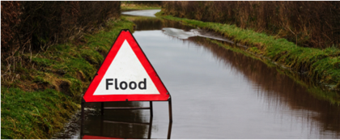
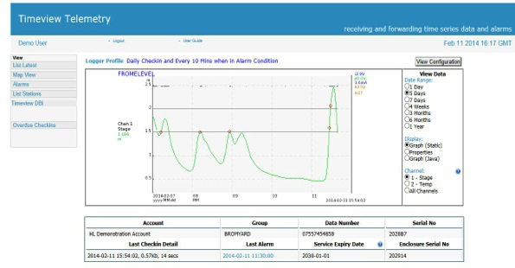
LeveLine-EWS flood alert system
Flood Warning
Damage to property caused by flooding is often sudden and always costly.
Installing a monitoring device to record water level at flood spots enables people to be alerted of rising water levels, giving them time to move possessions, evacuate areas and protect their assets.
LeveLine-EWS Telemetry System
The LeveLine-EWS is a specialised water level logger connected to a telemetry device. It constantly records water level, but more importantly it can send out warning alerts via Timeview.
Both SMS and emails can be sent to key people when alert levels are reached, allowing them to notify the community or to take action.
Anyone with login details can view the data, read or write access can be set.
www.aquaread.com info@aquaread.com +44 1843 600 030

Slide 20






Aquaread Social Media click to connect and stay in touch
www.aquaread.com info@aquaread.com +44 1843 600 030

